Slide 1

Bike Share Case Study
Presented by
Riya Gurung
September 2023

Slide 2


About the Company
In 2016, Cyclistic launched a successful bike-share offering. Since then, the program has grown to a fleet of 5,824 bicycles that are geotracked and locked into a network of 692 stations across Chicago. The bikes can be unlocked from one station and returned to any other station in the system anytime.
Until now, Cyclistic’s marketing strategy relied on building general awareness and appealing to broad consumer segments. One approach that helped make these things possible was the flexibility of its pricing plans: single-ride passes, full-day passes, and annual memberships. Customers who purchase single-ride or full-day passes are referred to as casual riders. Customers who purchase annual memberships are Cyclistic members.

Slide 3
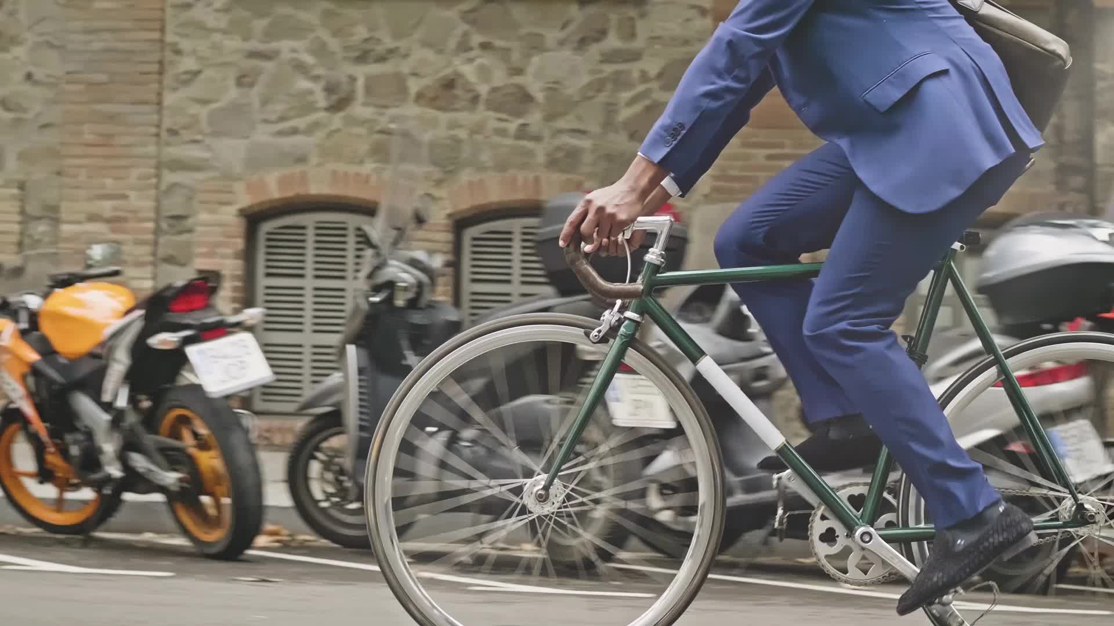
Business Problem
How do annual members and casual riders use Cyclistic bikes differently?
How to convert Casual riders into Member riders?

Slide 4
Case Study Analysis
Rstudio was used for complete data analysis

Slide 5
Bike ride data from Jan 22-Dec22

Slide 6
Types of Riders
Casual Riders (riders who buy single day passes or full day passes
2322032
Member Riders (who buys annual memberships)
33455685

Slide 7
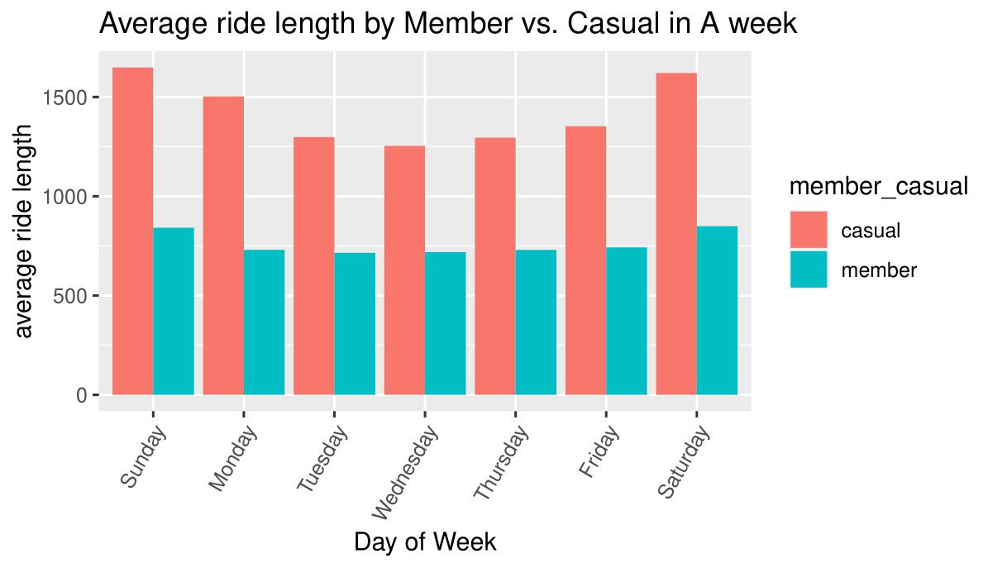
Average Ride length by different riders
average ride length is higher in Casual riders compared to Member riders
appeared Casual riders rode almost twice longer time than the Member riders every day of the week.

Slide 8
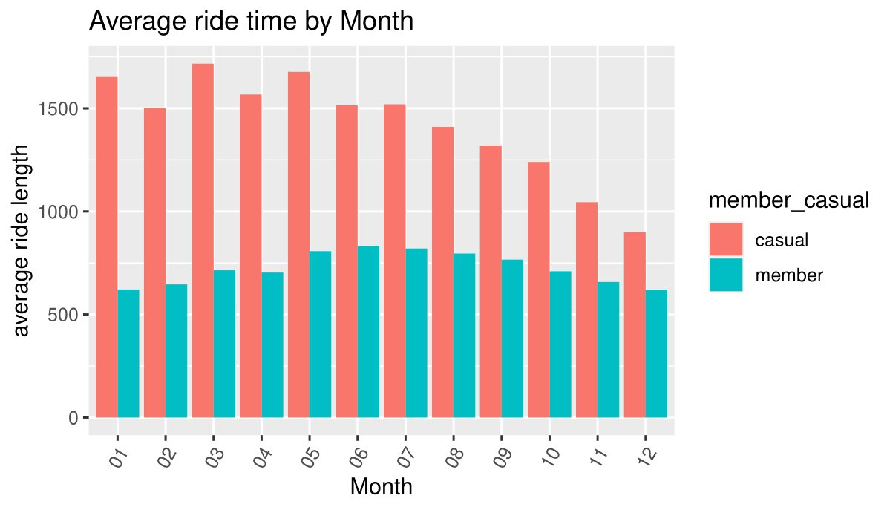
Average Ride time by month
higher ride length by Casual riders on average compared to member riders
Member riders ride pattern appeared more consistent throughout the month

Slide 9
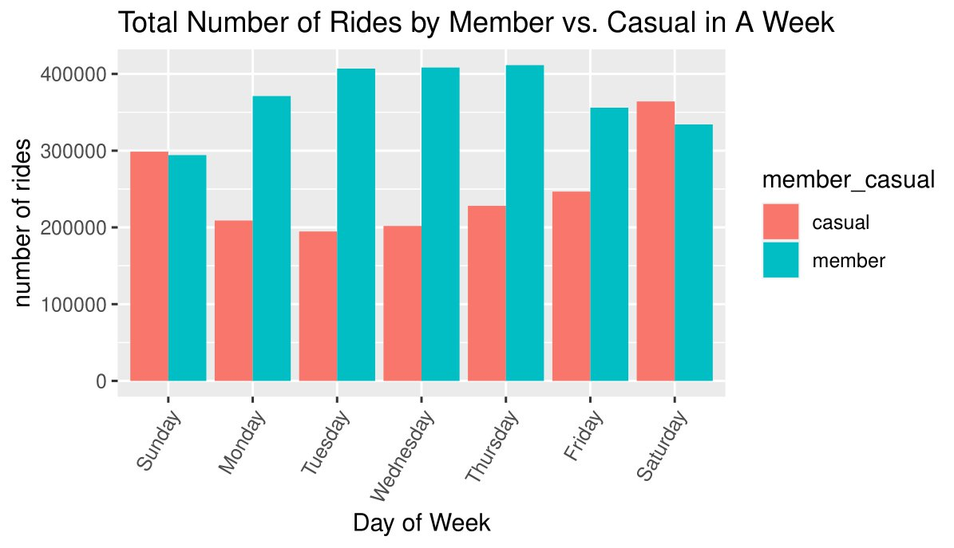
Total Number of Rides by Riders
Member riders appeared to ride more than the Casual riders in a week
Member riders ride pattern is more consistent throughout the week whereas, the Casual riders use fewer rides on weekdays and more on weekends

Slide 10
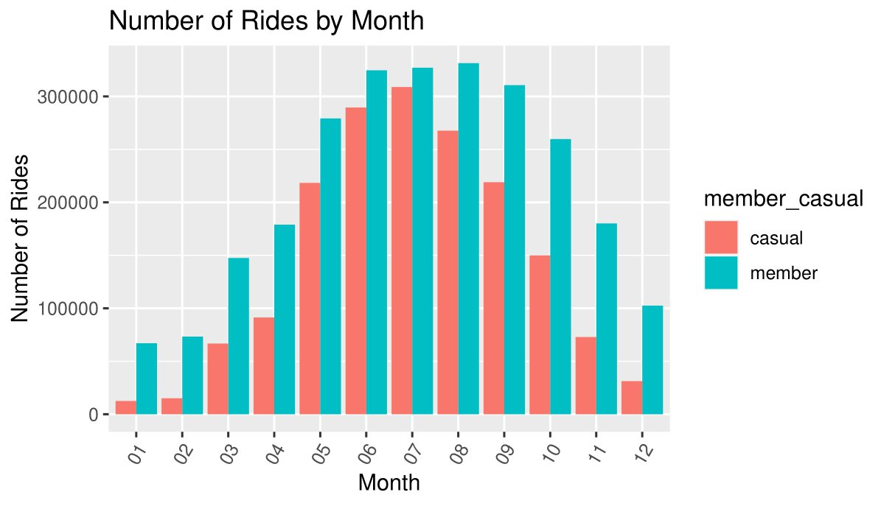
Number of Monthly rides
The Casual riders used the rides mostly in July whereas Member riders used mostly from June until August
Number of rides decreased in January for both riders

Slide 11
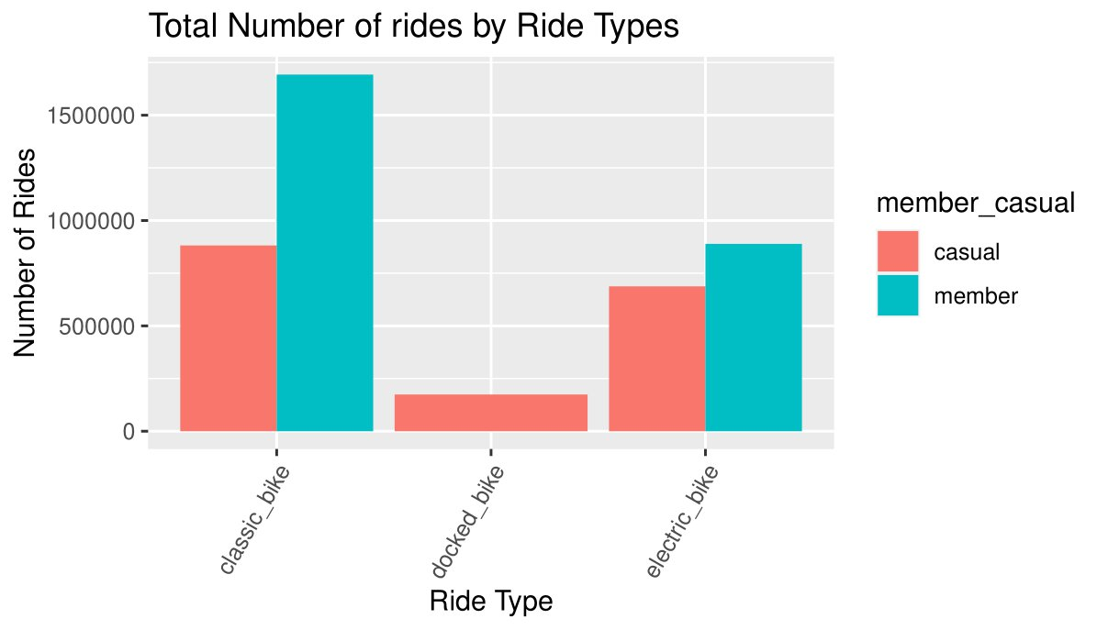
Total number of rides by Ride types
Classic bike appeared to be mostly used by both Member and Casual riders

Slide 12
Conclusion
The Casual riders appeared to ride the bikes for longer time than the Member riders. However, member riders used bikes more consistently as compared to casual riders who rode the bikes more often on weekends and summertime. The bike data patterns and trends indicate that casual riders ride bikes more often for leisure and recreational activities whereas the Member riders ride bikes more for commute to work.

Slide 13
Recommendations
The data shows that the casual riders ride more on weekends and Summertime so targeted promotions can be implemented by offering special discounts, or incentives to casual riders who sign up for membership
Promote awareness of membership benefits and potential cost savings to the casual riders so they will be attracted towards getting a membership compared to paying for single rides
Increase single ride pays in order to encourage Casual riders to become Member riders utilizing membership perks

